Slide 1

Basic Psychological Tracking Calendar GitHub: https://github.com/CactuarBen/IU_Project Hosted website: (slow) https://iu-project.onrender.com/

Slide 2
Aim of the work: Creation of a Psychological Well-being Tracker, which is designed to help users monitor and manage their psychological health. The functionality involves: - tracking mood (4 pre-set values to choose from) - journal entries (describing the day, stoic approach) - daily goals (logged at the end of the day) Ideally, the user would be able to click through the months and examine his state at various times and how the events happening defined their state. Together with the goals, the user could see how their state impacted their productivity as well.

Slide 3
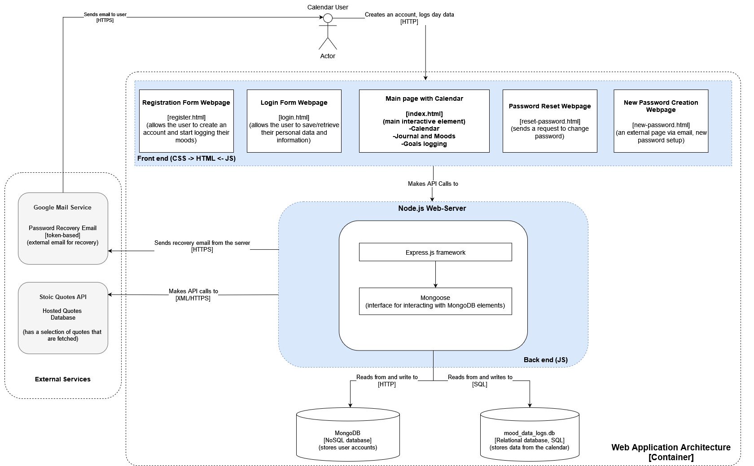
Architecture
index.html – main page with the calendar and entries
login.html/register.html – pages that allow the user to register and use the resource
reset/new-password.html – pages that allow the user to reset their passwords
server.js – the back-end of the website that facilitates communication with the databases (MongoDB and DB). Sets up the Node.js web server using the Express.js framework and facilitates routing, user authentication, and database queries.
auth.js – the list of functions used by login/register/reset/new-password.html pages
Node.js and Express.js frameworks – web server frameworks that host the application. Node.js runs JavaScript on the server-side, while Express.js simplifies routing, fetching and posting.
MongoDB – A NoSQL database that stores user account information (such as usernames, passwords, emails). It's used to manage user authentication and related data.Mongoose – The interface used to return the MongoDB elements.
mood_data_logs.db – This is a database that stores the entries made by users into the index.html page. Records mood logs, journal entries, or other types of user-generated data in the calendar.
Stoic Quotes API – the quotes that appear in the top part of index.html (https://github.com/benhoneywill/stoic-quotes)
Google Mail service – an email created for recovering accounts with forgotten passwords.

Slide 4
Technologies used
HTML: Creating the barebone webpages (login.html, register.html, reset-password.html, new-password.html)
CSS: Stylesheet that unifies the styles of the HTML pages mentioned above (styles.css)
JavaScript: used for both front (auth.js and script.js) and back-end (server.js)
FetchAPI: API that sends HTTP requests to the server.js
Stoic quotes external API (gets a random quote from the service) and Gmail hosted email for password recovery.
Node.js: used to run the back-end for the server side (server.js)
Express.js: framework used to build the server on the nodeJS
MongoDB: NoSQL database that stores the information about the users
SQLite: a relational database that stores information about user’s moods, journals and goals.
Nodemailer: a library used to send emails with recovery information
Body-parser: a library that parses the request bodies to make their handling easier
Mongoose: ODM (Object Data Modeling) library for MongoDB

Slide 5
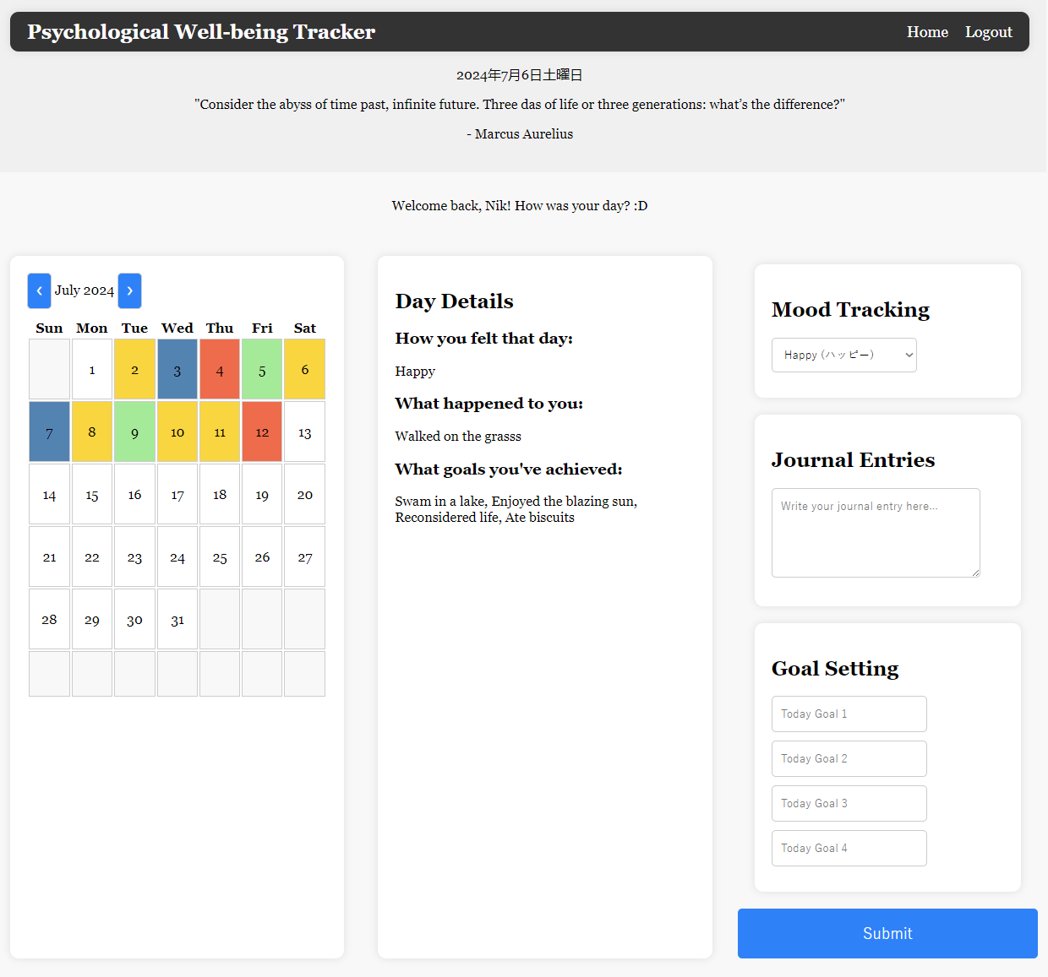
Index.html and Script.js
Navigation bar with links to index.html and logout
The current date and the quote from Stoic API
The special welcome message from MongoDB.db
The calendar with the colors, month changer
Day details that display logs of the logged days
Mood tracker: choose color of a day (mood-based)
Journal entries: how your day went (text area)
Goals: input only 4 goals (Harvard suggestion)

Slide 6
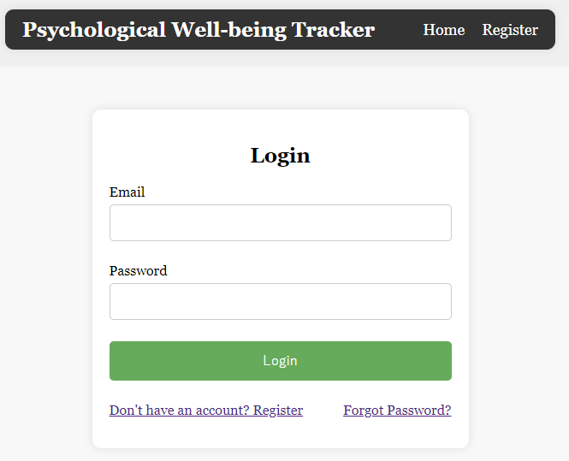
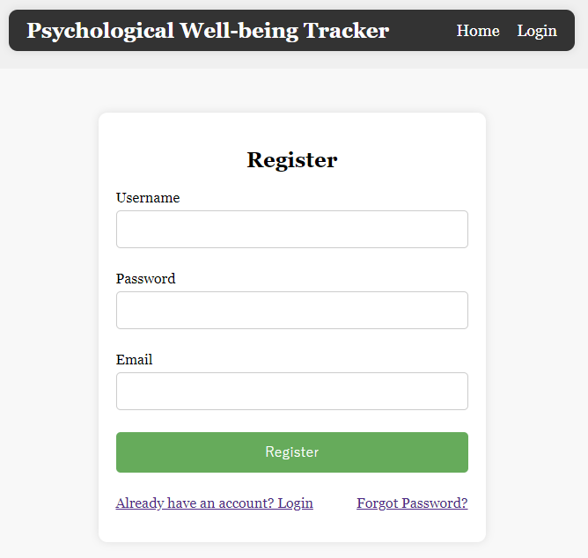
Login and Register
Share a common .js file – auth.js
The registration page requires a user email, username, and password.
The said email is used as login for the page with the password, while the username is used exclusively in the welcome message
The userID is used to save data in the local SQLite database
The forgot password leads to the two other windows that allow the user to change their password

Slide 7
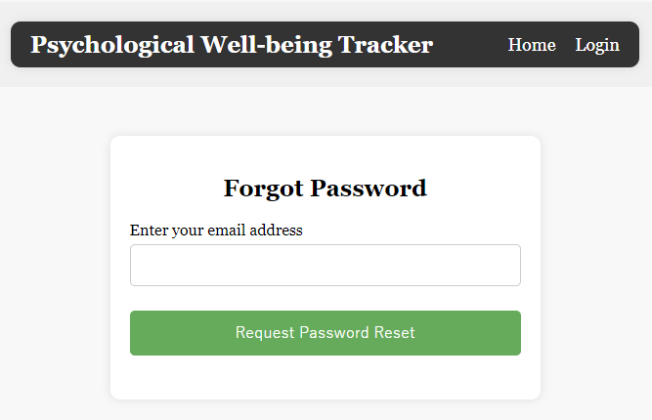
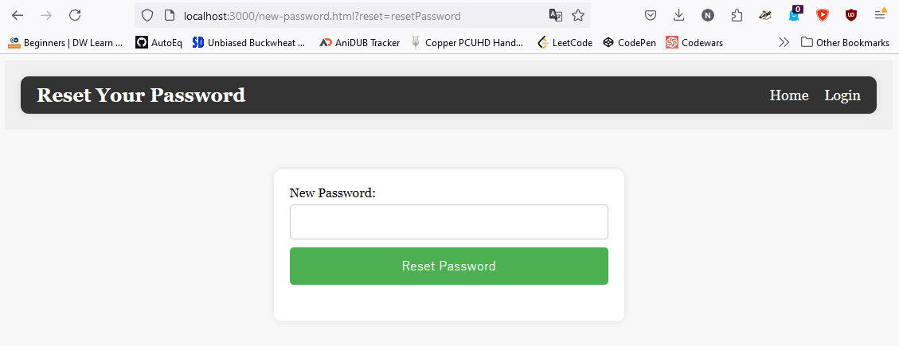
Forgot password Reset password
reset-password allows the user to reset their password, by typing in their email and receiving a reset email
Clicking the reset email writes the html page address in the window and appends a token (static) “resetPassword” that allows the password change to occur

Slide 8
Changes/Ideas
Due to the overall difficulty of setting up the user account features, the following ideas will be considered for the final part:
Re-writing logged data into the SQLite database (currently the same day data can not be changed after submission)
Hashed passwords (stored on MongoDB) for the sake of security (harder to debug)
Regex for checking the email format (a basic feature, yet makes it much harder to debug)
Server.js can be extended with try{}-catch{} sequences for common HTTP status codes (due to difficulty of finding issues)
The website is responsive enough, but maybe something is missing (media queries? Yet it works on mobile fairly well)
Add more console.log() statements for debugging (most common issues was the calendar breaking and password changes)
*the phase I was created to be as a bare-minimum guide, which was supposed to be implemented fully. Most of the content from the previous stage is present in the phase II, except:
Weekly notifications were scrapped, as they are redundant and would only annoy the users who fill out their data daily. The service shouldn’t be invasive and disturb the user.
Data analysis would prove to involve more libraries and itself it is a field where I don’t have enough experience in, so it will take a lot of time to develop and bring little benefit.

Slide 9
Test Cases
Feature tested | Action | Expected Result | Actual Result
Creation of a user | Press on login and then fill in the name, email and password. | The user “Daniel”is created and is greeted by his name in the login screen | The user “Daniel”is created and is greeted by his name in the login screen
Logging data into the calendar | Choose 1st of September and log data for each available slot. | Data is submitted successfully, and the day changes its color. | Data is submitted successfully, and the day changes its color.
Review the saved data | Refresh the page and press on September 1st | The data you’ve input is shown under “Day details” | The data you’ve input is shown under “Day details”
Changing the saved data | The date with the saved data will be selected again with the mood, journal and goals changed, then submitted. | The mood (color), journal and goals were changed, and once they are pressed, the newer submission is shown. | The mood (color), journal and goals were changed, and once they are pressed, the newer submission is shown.
Changing the months | Press on the forward arrow and the backward arrow to change months. | The months are changed forward and backward, without skipping any between | The months are changed forward and backward, without skipping any between
Logout | Press on Logout button and make sure you are logged out. | The user is logged out and the message shows “Oops! Seems like I don't know you. Please log in so that I could take a closer look :)” | The user is logged out and the message shows “Oops! Seems like I don't know you. Please log in so that I could take a closer look :)”
Recover Password | Navigate to ”Login” and press on the “Forgot password?”. Enter your email. | The notification about the email being sent is shown and you receive an email with recovery. | The notification about the email being sent is shown and you receive an email with recovery.
Set a new Password | Open the password reset link and write a new password | The new password is configured and the user can log in with it. | The new password is configured and the user can log in with it.
Check the passwords for the correct format | Try inputting a password with <8 characters, no capital letters and no small letters as well as no numbers. | 4 errors appear, notifying the user to add one capital letter, one small, one number and more than 8 in total. | 4 errors appear, notifying the user to add one capital letter, one small, one number and more than 8 in total.
Home button returns you to the calendar | Press on either the home button or the name of the tracker in the left to return home. | The user is returned home. | The user is returned home.
The stoic quote is show in the top part under the date | Refresh the page and wait for the quote to appear | The stoic quote appears below the date and above the user welcome message. | The stoic quote appears below the date and above the user welcome message.
Supports mobile devices | Open the development tools and chose the smallest available screen being IPhone SE | The website is stable, with no visual artifacts, all features can be used. | The website is stable, with no visual artifacts, all features can be used.
Try inputting long sentences into the goals and journal and make sure they don’t overflow. | Inputting and saving goals that exceed the text box, shows them within the container with the data. | No character overflowing the container it is in occurs. The sentences are shown without glitches. | No character overflowing the container it is in occurs. The sentences are shown without glitches.

Slide 10
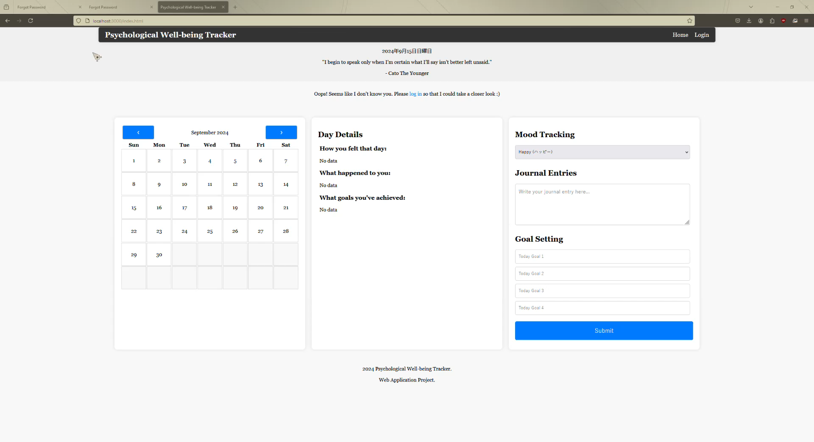
Demonstration

